Slide 1
Planar Graphs
Dr Honey Sharma
GGI, Ludhiana
Reference Book: Kenneth H. Rosen, Discrete Mathematics and its Applications, 7th ed, McGraw Hill

Slide 2
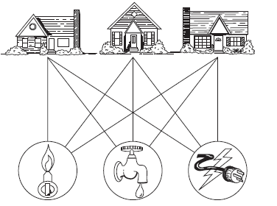
Consider the problem of joining three houses to each of three separate utilities, as shown in below Figure. Is it possible to join these houses and utilities so that none of the connections cross?

Slide 3
This problem can be modeled using the complete bipartite graph K3,3. The original question can be rephrased as: Can K3,3 be drawn in the plane so that no two of its edges cross?
In this section we will study the question of whether a graph can be drawn in the plane without edges crossing. In particular, we will answer the houses-and-utilities problem.

Slide 4
Planar Graphs
A graph is called planar if it can be drawn in the plane without any edges crossing
Representation examples: K1,K2,K3,K4 are planar, Kn for n>4 are non-planar
K₄

Slide 5
Planar Graphs
Representation examples: Q₃

Slide 6
Euler’s formula
A planar representation of a graph splits the plane into regions, including an unbounded region.
EULER’S FORMULA Let G be a connected planar graph with e edges and v vertices. Let r be the number of regions in a planar representation of G. Then r = e − v + 2.

Slide 7
Planar Graphs
Example of Euler’s theorem
A planar graph divides the plane
into several regions (faces), one
of them is the infinite region.
R1
R2
R4
v=4, e=6 ,r=4,
v-e+r=2
R3
K₄

Slide 8
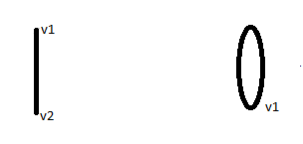
Proof of Euler’s formula
We will proof the theorem by method of Induction on the number of edges of the graph.
Base Case: let G be a grah having 01 edge only. There are two possible graphs in this case
e=1, v=2, r=1 e=1, v=1, r=2
e-v+r=2 e-v+r=2
Now lets assume, Eulers Formuls holds true for all connected planner graphs having n edges.
Let {an+1, bn+1} be the edge that is added to Gn to obtain Gn+1 and we prove that r_{n} = e_{n} – v_{n} + 2 is true. Can be proved using two cases.

Slide 9
Let G be a Graph with n+1 edges.
If G has a vertex of degree one, the removal of this vertex along with egde incident with it, will yield connected graph G’.
Therefor Eulers formula holds true for G’. On adding the removed egde back in G’, will increase the number of vertices by one and edge by one but number of regions remains same. Hence results holds for G.
r_{n+1} = r_{n} ,
e_{n+1} = e_{n} + 1,
v_{n+1} = v_{n} + 1
v_{n+1} - e_{n+1} + r_{n+1} = 2
a_{n+1}
R
b_{n+1}

Slide 10
If G does not have a vertex of degree one, the nremoval of any egde from the boundary, will yield connected graph G’ with n edges.
Therefor Eulers formula holds true for G’. On adding the removed egde back in G’, will increase the number of edges by one and region by one but number of vertices remains same. Hence results holds for G.
r_{n+1} = r_{n} + 1,
e_{n+1} = e_{n} + 1,
v_{n+1} = v_{n}
v_{n+1} - e_{n+1} + r_{n+1} = 2
a_{n+1}
R
b_{n+1}

Slide 11
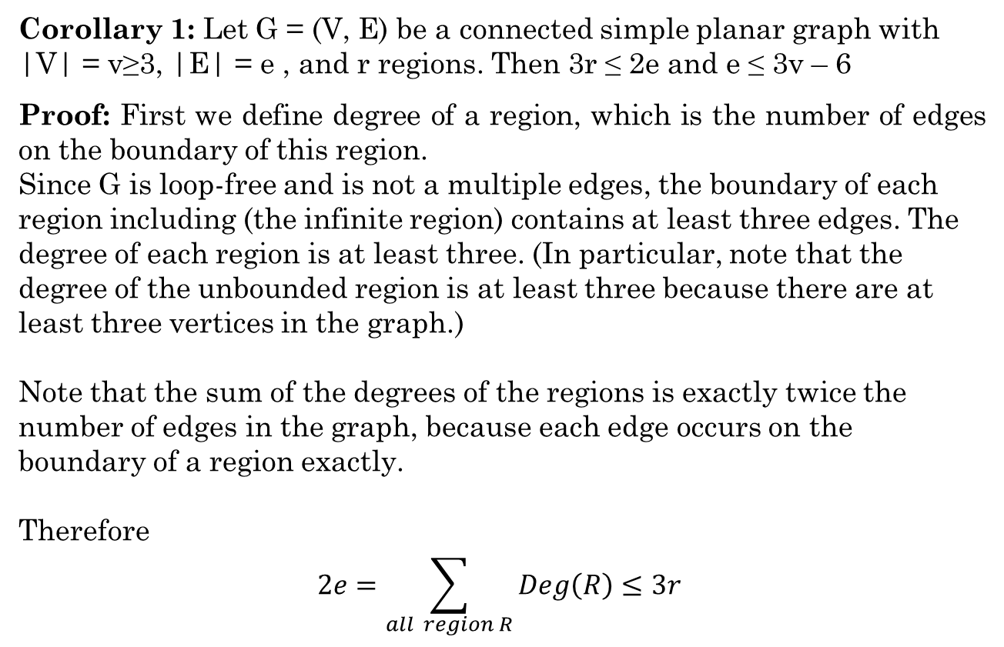
Planar Graphs
Corollary 1: Let G = (V, E) be a connected simple planar graph with |V| = v≥3, |E| = e , and r regions. Then 3r ≤ 2e and e ≤ 3v – 6
Proof: First we define degree of a region, which is the number of edges on the boundary of this region.
Since G is loop-free and is not a multiple edges, the boundary of each region including (the infinite region) contains at least three edges. The degree of each region is at least three. (In particular, note that the degree of the unbounded region is at least three because there are at least three vertices in the graph.)
Note that the sum of the degrees of the regions is exactly twice the number of edges in the graph, because each edge occurs on the boundary of a region exactly.
Therefore
$$2e=\sum_{all region R}{Deg\left(R\right)≤3r }$$

Slide 12
r ≤ (2/3) e
From Euler’s theorem, 2 = v – e + r
2 ≤ v – e + 2e/3
2 ≤ v – e/3
e ≤ 3v – 6

Slide 13
Problem : Show that K5 is nonplanar
Solution: The graph K5 has five vertices and 10 edges. However, the inequality e ≤ 3v − 6 is not satisfied for this graph because e = 10 and 3v − 6 = 9. Therefore, K5 is not planar

Slide 14
Corollary 2: Let G = (V, E) be a connected simple planar graph then G has a vertex degree that does not exceed 5
Proof: If G has one or two vertices the result is true
If G has 3 or more vertices then by above result e ≤ 3v – 6
2e ≤ 6v – 12
If the degree of every vertex is at least 6:
by Handshaking theorem: 2e = ∑ (deg(v))
2e ≥ 6v.
But this contradicts the inequality 2e ≤ 6v – 12
Hence, here must be at least one vertex with degree no greater than 5

Slide 15
Corrolarly: If a connected planar simple graph has e edges and v vertices with v ≥ 3 and no circuits of length three, then e ≤ 2v − 4.
Proof:- The proof of Corollary is similar to that of above Corollary, except that in this case the fact that there are no circuits of length three implies that the degree of a region must be at least four.
2e≤4r

Slide 16
Solution of problem of three houses / three utilities
As discussed earlier this this problem can be modeled using the complete bipartite graph K3,3. So we have to check whether K3,3 is planner or not?
As K3,3 has no circuits of length three (this is easy to see because it is bipartite), therefore above Corollary can be used.
K3,3 has six vertices and nine edges. As e = 9 and 2v − 4 = 8, above corollary shows that K3,3 is nonplanar.

Slide 17
Planar Graphs
Representation examples: K_{3,3} is Nonplanar
v₁
v₂
v₃
v₁
v₅
v₁
v₅
R₂₁
R₂
R₁
R₁
R₂₂
v₃
v₄
v₅
v₆
v₄
v₂
v₄
v₂

Slide 18
Theorem: (Kuratowski Theorem)A graph is nonplanar if and only if it contains a subgraph homeomorphic to K_{3,3} or K₅.

Slide 19
APPLICATIONS OF PLANAR GRAPHS
Planarity of graphs plays an important role in the design of electronic circuits. We can model a circuit with a graph by representing components of the circuit by vertices and connections between them by edges. We can print a circuit on a single board with no connections crossing if the graph representing the circuit is planar. When this graph is not planar, we must turn to more expensive options. For example, we can partition the vertices in the graph representing the circuit into planar subgraphs. We then construct the circuit using multiple layers. We can construct the circuit using insulated wires whenever connections cross.

Slide 20
The planarity of graphs is also useful in the design of road networks. Suppose we want to connect a group of cities by roads. We can model a road network connecting these cities using a simple graph with vertices representing the cities and edges representing the highways connecting them. We can built this road network without using underpasses or overpasses if the resulting graph is planar.

